Slide 1

INTERNET OF THINGS
IoT Network Architecture and Design
Dr. Nagegowda K S
Department of Computer Science & Engineering

Slide 2

INTERNET OF THINGS
Introduction to IoT
Chapter2: IoT Network Architecture and Design
Dr. Nagegowda K S
Department of Computer Science & Engineering

Slide 3
INTERNET OF THINGS
Agenda
Drivers Behind New Network Arhitectures
Comparing IoT Architectures
A Simplified IoT Architecture
The Core IoT Functional Stack
IoT Data Management and Compute Stack

Slide 4
INTERNET OF THINGS
Drivers Behind New Network Arhitectures
Challenges:
Scale
Security
Devices and networks constrained by power, CPU, memory, and link speed.
The massive volume of data generated.
The support for legacy devices
The neeed for data to be analyzed in real time

Slide 5
Security
INTERNET OF THINGS
Be able to identify and authenticate all entities involved in the IoT service (that is,
gateways, endpoint devices, home networks, roaming networks, service platforms)
Ensure that all user data shared between the endpoint device and back-end applications is encrypted
Comply with local data protection legislation so that all data is protected and
stored correctly
Utilize an IoT connectivity management platform and establish rules-based security policies so immediate action can be taken if anomalous behavior is detected from connected devices
Take a holistic, network-level approach to security

Slide 6
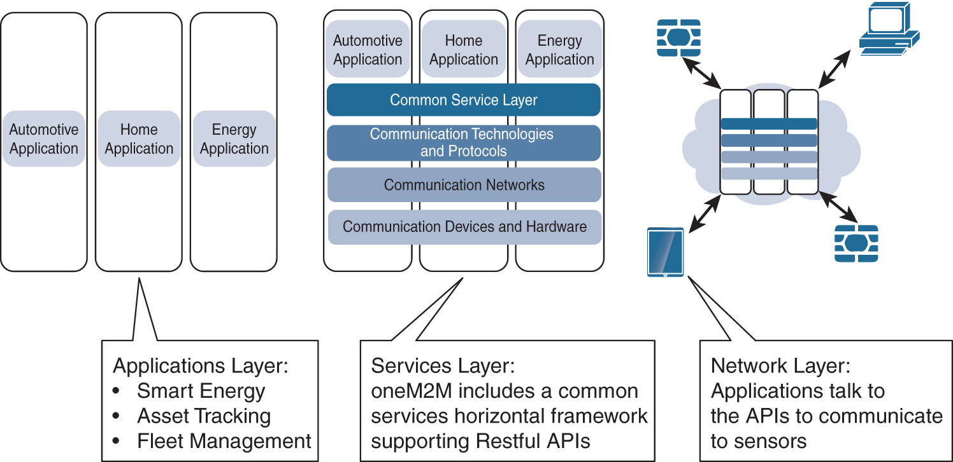
INTERNET OF THINGS
The oneM2M IoT Standardized Architecture

Slide 7
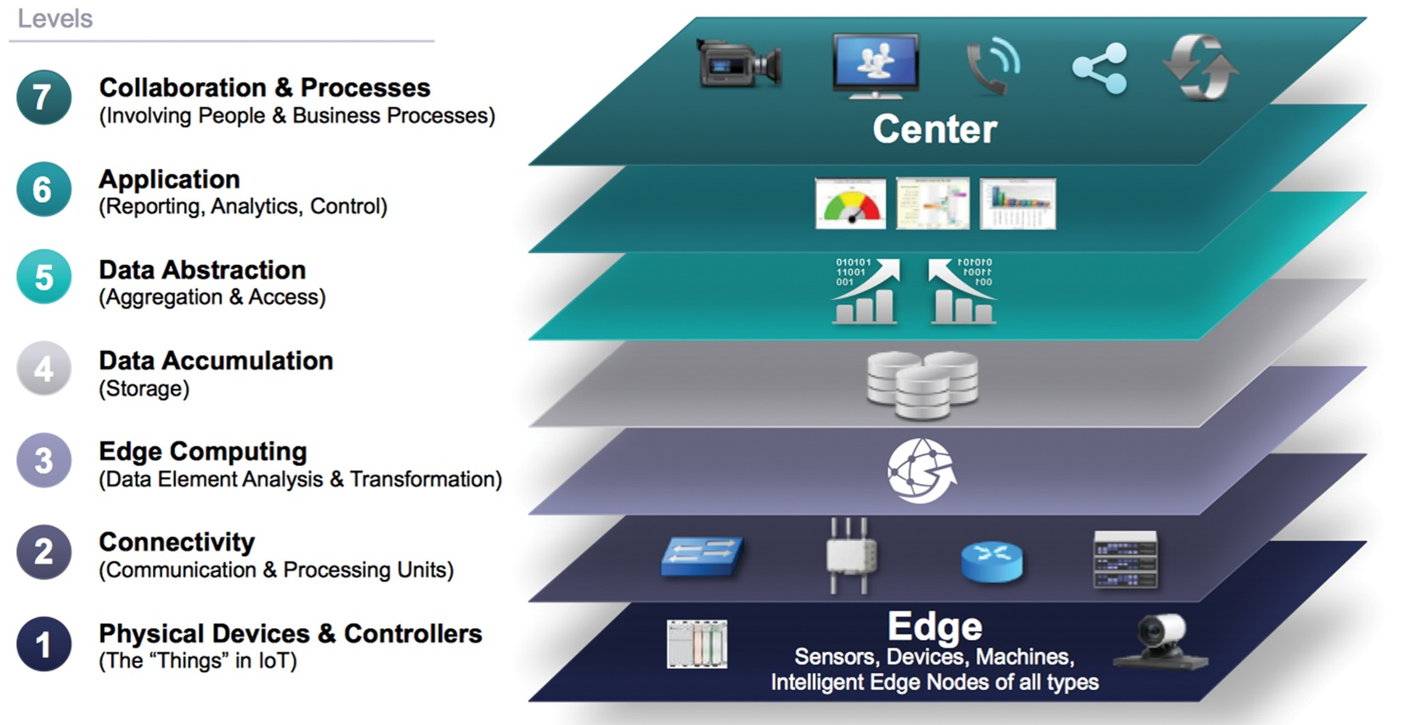
INTERNET OF THINGS
The IoT World Forum (IoTWF) Standardized Architecture

Slide 8
INTERNET OF THINGS
The IoT World Forum (IoTWF) Standardized Architecture
Using this reference model, we are able to achieve the following:
Decompose the IoT problem into smaller parts
Identify different technologies at each layer and how they relate to one another
Define a system in which different parts can be provided by different vendors
Have a process of defining interfaces that leads to interoperability
Define a tiered security model that is enforced at the transition points between levels

Slide 9
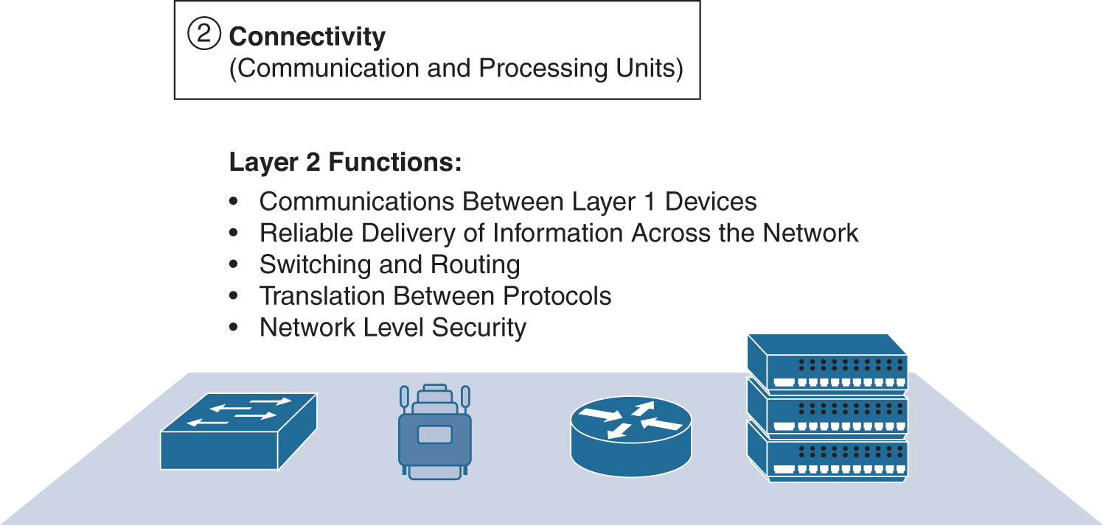
INTERNET OF THINGS
Seven layers of the IoT Reference Model
Physical Devices and Controllers Layer
Connectivity Layer

Slide 10
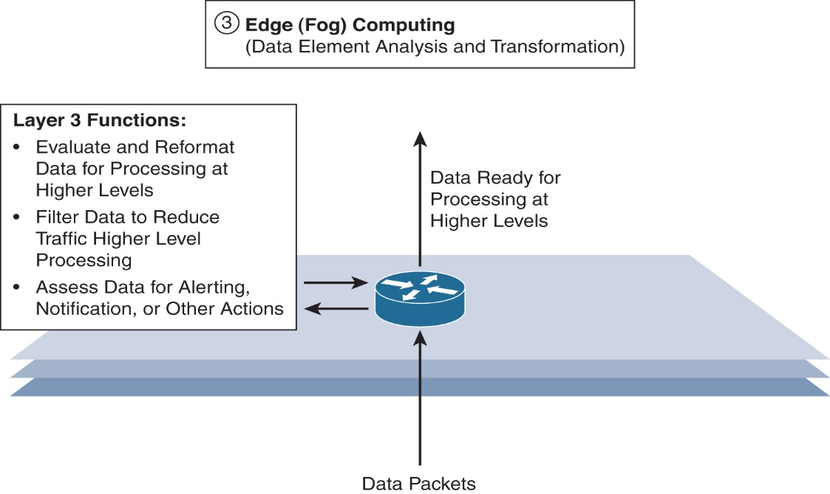
INTERNET OF THINGS
Seven layers of the IoT Reference Model
Edge Computing Layer

Slide 11
INTERNET OF THINGS
Seven layers of the IoT Reference Model
Layers 4-7

Slide 12
INTERNET OF THINGS
Additional IoT Reference Model

Slide 13
THANK YOU
Dr. Nagegowda K S
Department of Computer Science & Engineering
nagegowda@pes.edu

